Slide 1
Q-learning for LMDPs
Bachelor Degree Thesis
Cristina Gálvez
Universitat Pompeu Frabra
2023

Slide 2
Table of contents
01
02
03
04
Introduction
Background
Reinforcement Learning and Sequential Decision Problems
MDPs and LMDPs
Q-learning and Z-learning
Contribution
Results
Q-learning for LMDPs
Evaluation and comparisson of the methods

Slide 3
Introduction

Slide 4
Reinforcement Learning deals with Sequential Decision-Making Problems
Artificial Intelligence
…
Machine Learning
…
Supervised Learning
Unsupervised Learning
Reinforcement Learning

Slide 5


Sequential Decision-Making Problems
S₁
S₂
S₃
a₁
a₄
S₄
S₅
S₆
a₂
a₃
S₇
S₈
S₉

Slide 6
Transitions & Rewards
-1 | -1 | 10
-1 | -1 | -1
-1 | -1 | -1
+r_{t}
S₁
S₂
a₂

Slide 7
Background

Slide 8
Policies
Deterministic
Stochastic
0
0
0
1
0
1
0
0
0.5
0.5
1
0
0.5
0
0.5
0
0
0
0
0
0.5
0.5
1
0
0.5
0
0.5
0
0
0
0
0

Slide 9
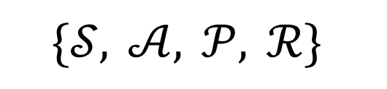
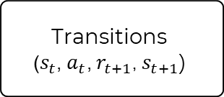
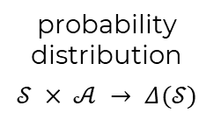
Markov Decision Processes
$$\{𝒮, 𝒜, 𝒫, ℛ\}$$
rewards
states
probability distribution
$$𝒮 × 𝒜 → Δ(𝒮)$$
actions
Markov Property
Transitions
$$\text{(}s_{t}\text{,} a_{t}\text{,} r_{t+1}\text{,}{ s}_{t+1}\text{)}$$
Value Functions

Slide 10


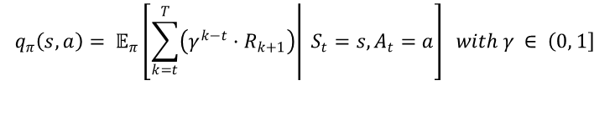
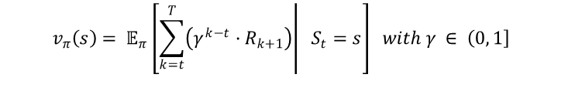

Value Functions
expected total reward
$v$-values
$q$-values
for each state
for each state and action
$$v_{π}\left(s\right)= 𝔼_{π}\left[\left.\sum_{k=t}^{T}{\left(γ^{k−t}·R_{k+1}\right)}\right| S_{t}=s\right] with γ ∈ \left(0\right., \left.1\right]$$
$$q_{π}\left(s, a\right)= 𝔼_{π}\left[\left.\sum_{k=t}^{T}{\left(γ^{k−t}·R_{k+1}\right)}\right| S_{t}=s, A_{t}=a\right] with γ ∈ \left(0\right., \left.1\right]$$
10 | 0
9 | 10
for $π$
9
0
9
10
0
0
8
0
9
10
8
9
8
9
8
9

Slide 11
Q-learning for MDPs
$$\hat{Q}\left(s_{t}, a_{t}\right)←\left(1−α_{t}\right)·\hat{Q}\left(s_{t}, a_{t}\right)+α_{t}\left[r_{t+1}+ γ\max_{a}{\hat{Q}\left(s_{t+1}, a\right)}\right]$$
0
0
0.2
0
9
0
0
0
0
0
0
1
0
0
9
10
0
0
0
0
0
0
8
0
…
0
0
0.1
0
9
10
0
0
0
0
0
0
0
0
8
9
8
9
0
0
0
0
8
9

Slide 12

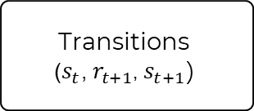
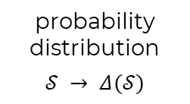
Linearly-solvable Markov Decision Processes
Implicit actions case
$$\{𝒮, 𝒫, ℛ\}$$
rewards
states
probability distribution
$$𝒮 → Δ(𝒮)$$
Deterministic Problems
Transitions
$$\text{(}s_{t}\text{,} r_{t+1}\text{,}{ s}_{t+1}\text{)}$$
Value Functions

Slide 13



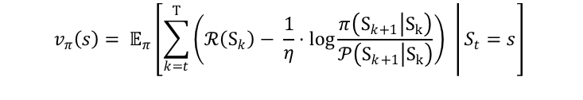
Value Functions
expected total reward
for $π$
$z$-values
for each state
$$z\left(s\right)= e^{η·v\left(s\right)}$$
9.52… | 1
8.04… | 9.52…
$$v_{π}\left(s\right)= 𝔼_{π}\left[\left.\sum_{k=t}^{T}{\left(ℛ\left(S_{k}\right)− \frac{1}{η}·\log{\frac{π\left(S_{k+1}\left|S_{k}\right.\right)}{𝒫\left(S_{k+1}\left|S_{k}\right.\right)}}\right) }\right|S_{t}=s\right]$$

Slide 14

Z-learning for LMDPs
$$\hat{Z}\left(s_{t}\right)←\left(1− α_{t}\right)· \hat{Z}\left(s_{t}\right)+ α_{t}·e^{ηr_{t+1}}\sum_{s}{P\left(s\right|s_{t})·\hat{Z}\left(s\right)}$$
1 | 1
1 | 1
0.997… | 1
0.93… | 1
0.58… | 1
0.16… | 0.58…
…

Slide 15
Contribution

Slide 16
Q-learning for LMDPs
LMDPs
Q-values
Explicit actions
More efficient computationally
For each pair of state and action
As traditional
MDPs
Modelling
Policy derivation
As opposed to Z-learning, no modelling required
Optimal policy derived from q-values

Slide 17
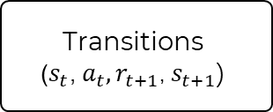
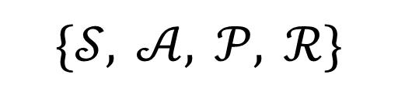
Linearly-solvable Markov Decision Processes
Explicit actions case
$$\{𝒮, 𝒜, 𝒫, ℛ\}$$
rewards
states
probability distribution
$$𝒮 × 𝒜 → Δ(𝒮)$$
actions
Deterministic Problems
Transitions
$$\text{(}s_{t}\text{,}{ a}_{t},r_{t+1}\text{,}{ s}_{t+1}\text{)}$$
Q-values
(pairs state-action)

Slide 18

Q-learning for LMDPs
$$\hat{Q}\left(s_{t}, a_{t}\right)←\left(1−α\right)·\hat{Q}\left(s_{t}, a_{t}\right)+α{\frac{1}{A} e}^{ηr_{t+1}}\sum_{a^{′}}{\hat{Q}\left(s_{t+1},a^{′}\right)}$$
1
1
0.93
1
0.11
1
1
1
1
1
1
1
1
1
0.11
1
1
1
1
1
1
1
0.02
1
…
1
1
0.93
1
0.11
1
1
1
1
1
1
1
1
1
0.02
0.11
0.02
0.11
1
1
1
1
0.02
0.11

Slide 19




Policy
$$π\left(a | s\right)= \frac{\hat{Q}\left(s, a\right)}{\sum_{a^{′}}{\hat{Q}\left(s,a^{′}\right)}}$$
0.93
1
At state $S_{1}$
1
0.99
1
1
1
1
$$π\left(a_{1} | s_{1}\right)= \frac{0.93}{0.93+0.99+1+1}=0.23…$$
0.93
1
1
1
1
1
probability of choosing $a_{1}$ a$t$ $s_{1}$
1
1

Slide 20
Algorithm
Q-learning for LMDPs
initialize Q[s, a] = 1 for all s and a
for each episode:
reset environment s_{t} = s₀
for each time-step:
a_{t} = choose_action(Q, s_{t})
r_{t+1}, s_{t+1} = perform_transition(a_{t})
Q[s_{t}, a_{t}] = (1 - α) * Q[s_{t}, a_{t}] + α / A * exp(η * r_{t+1}) * sum(Q[s_{t+1}])
if s_{t+1} is terminal:
end episode
s_{t} = s_{t+1}

Slide 21
Characteristics
Discrete Problems
Flexibility
It works best, because of the deterministic property
Learns from experience
No Modelling
Convergence
No need to know the inner workings of the problem
For all discrete deterministic problems
(no proved)

Slide 22
Results

Slide 23



Framework
Python
Jupyter Notebooks
Gymnasium

Slide 24
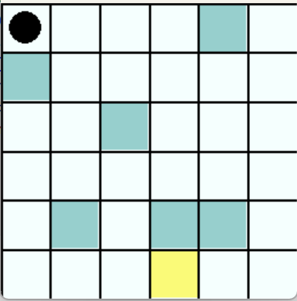
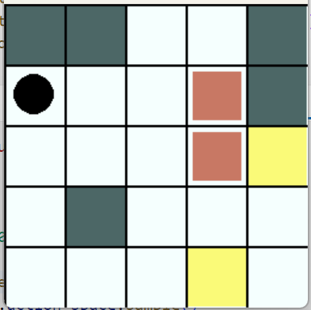
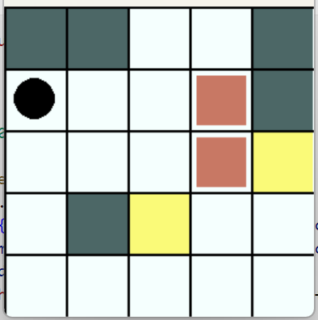
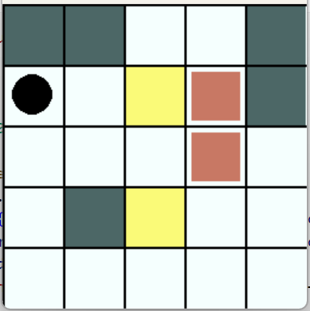
Problem Domains
Level 1
Level 2
Level 3
Frozen Lake
Sokoban

Slide 25
Comparisson of Methods
Over Training
Total Reward
Execution Time
Convergence
Over Resulting Policies
Total Reward

Slide 26
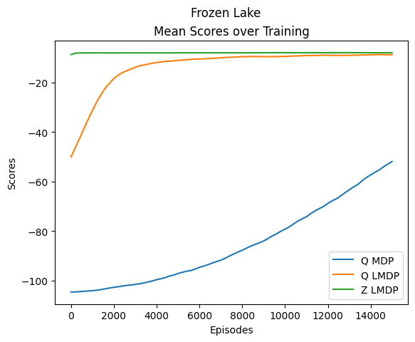
Total Reward
Over Training
Scores comparison for Frozen Lake with $α=0.1$

Slide 27
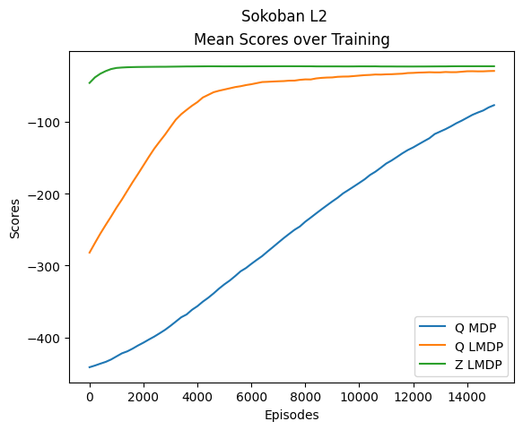
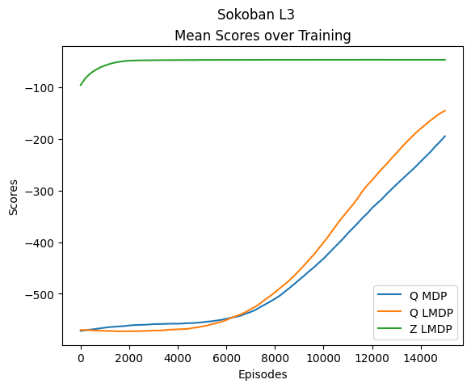
Total Reward
Over Training
Scores comparison for Sokoban levels 2 and 3, with $α=0.1$

Slide 28
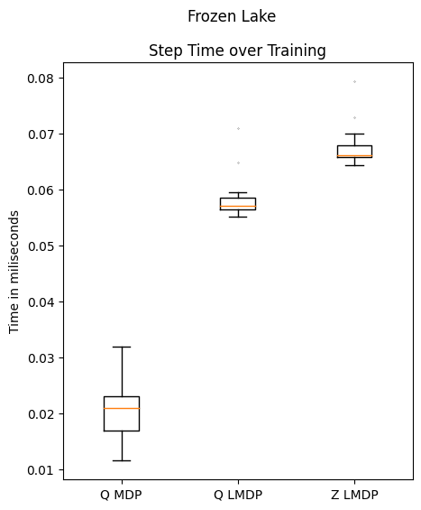
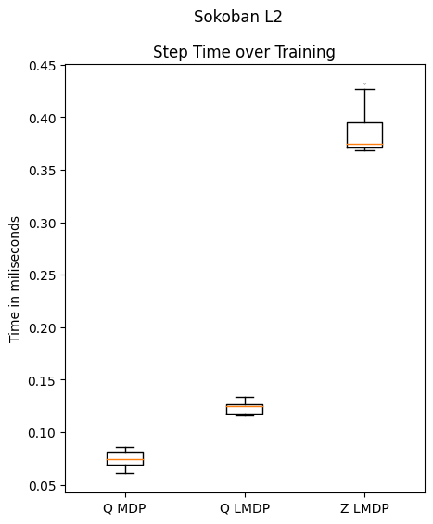
Execution Time
Over Training
Execution time per step in Frozen Lake and Sokoban level 2

Slide 29
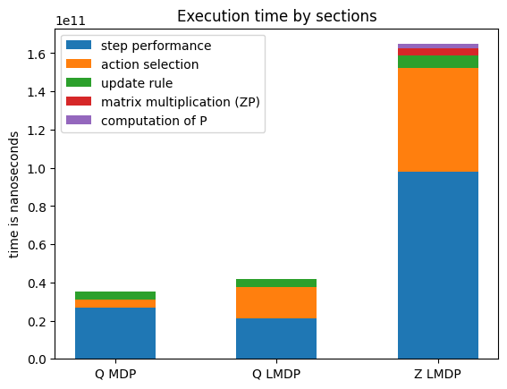
Execution Time
Over Training
Execution time distribution per section for Sokoban level 2

Slide 30
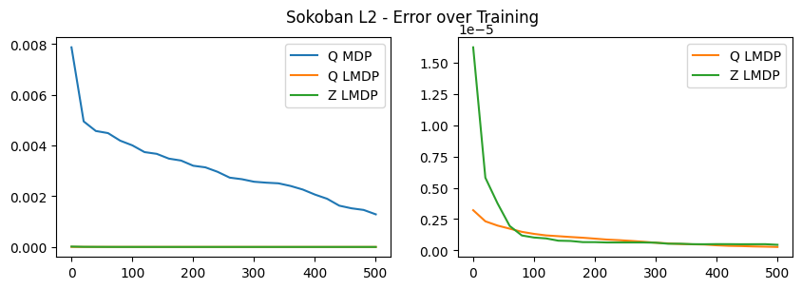
Convergence
Over Training
Convergence rate for Sokoban level 2

Slide 31
Total Reward
Over Resulting Policies
Q-learning for
MDPs
Q-learning for
LMDPs
Z-learning for
LMDPs
<
=

Slide 32
Conclusions

Slide 33
Q-learning for LMDPs
Explicit Actions
LMDPs
Performance
Modelling
Implementation
Convergence

Slide 34
Questions & Doubts

